Slide 1
Chapter 8 The Impact Of Technology On Winter Sport Tourism
Simon Hudson

Slide 2
Topics Covered
The impact of technology on marketing communications
The new consumer decision journey
Social media tools employed by winter sports marketers
The new mobile lifestyle
The impact of technology on operations
The impact of technology on clothing and equipment

Slide 3
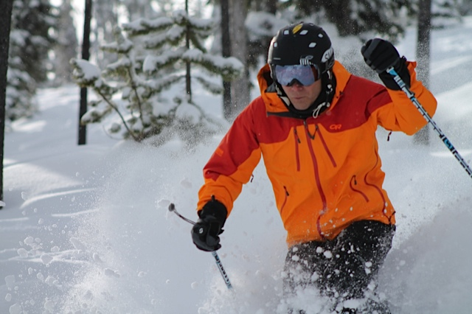
Spotlight Powder Matt: Social media maven
Everything is social now
authentic, be creative, and share
Social media
takes on the secondary role of guest relations
accurate, fun and an authentic voice

Slide 4
The impact of technology on marketing communications
The new consumer decision journey
a) consider; b) evaluate; c) buy; and d) enjoy, advocate and bond
Social media tools employed by winter sports marketer
Video; online brand community; Internet
Benefits and challenges
The new mobile lifestyle

Slide 5
Digital marketing communications options

Slide 6
The new consumer decision journey
Stage 2: Evaluate
Consumers add or subtract brands as they evaluate what they want
Active evaluation: information gathering, shopping
Stage 3: Buy
Consumer selects a brand at point of purchase
Stage 1: Consider
Top-of-mind consideration set from recent touch point
The Loyalty Loop
Post-purchase experience: Ongoing exposure
Stage 4: Enjoy, advocate, and bond
After purchasing, consumer builds expectation based on experience to help the next decision journey
Source: Adapted from Court et al. 2009

Slide 7
U.S. customer-acquisition growth by channel: Percentage of customers acquired
Source: Adapted from Aufreiter, Boudet & Weng, 2014

Slide 8
10 most popular social networking sites
Social networking site | Estimated unique monthly visitors (1,000s)
Facebook | 900,000
Twitter | 310,000
LinkedIn | 255,000
Pinterest | 250,000
Google + | 120,000
Tumblr | 110,000
Instagram | 100,000
VK | 80,000
Flickr | 65,000
Vine | 42,000
Source: Adapted from eBiz, 2014

Slide 9
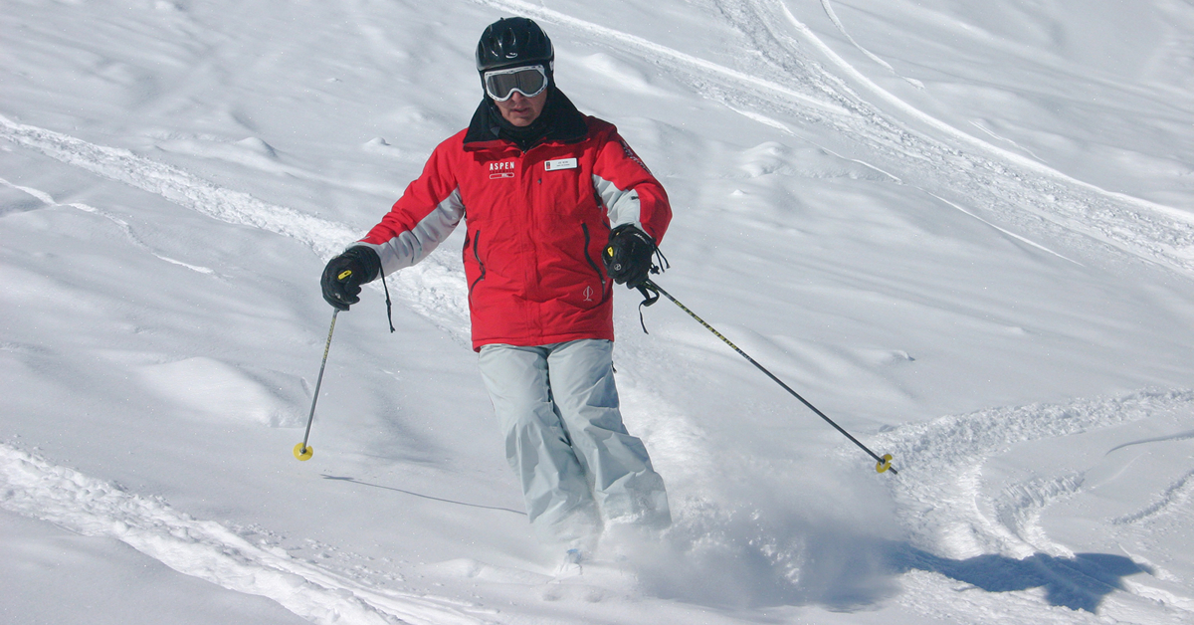
Profile Joe Nevin: From Apple to Aspen
Establish market, resort and product
Turn attention to marketing and choose the Internet as vehicle
Social networking as a tool for business promotion
Blogs,video, website, Facebook, YouTube and Twitter

Slide 10
Smartphone and tablet ownership by traveler and skier type
Source: Phocuswright, 2013, p. 13

Slide 11
Previous and planned use of mobile services
Source: Phocuswright, 2013, p. 15

Slide 12
The impact of technology on operations
RFID technology: ski lift
Tracking technology: assist safety
Mobile applications
Snowmaking

Slide 13
The impact of technology on clothing and equipment
Ski design innovations: with refinements in materials, size, shape and weight leading to today’s rocker hybrids.
The integration use of wearable technologies to monitor and track health and performance.

Slide 14
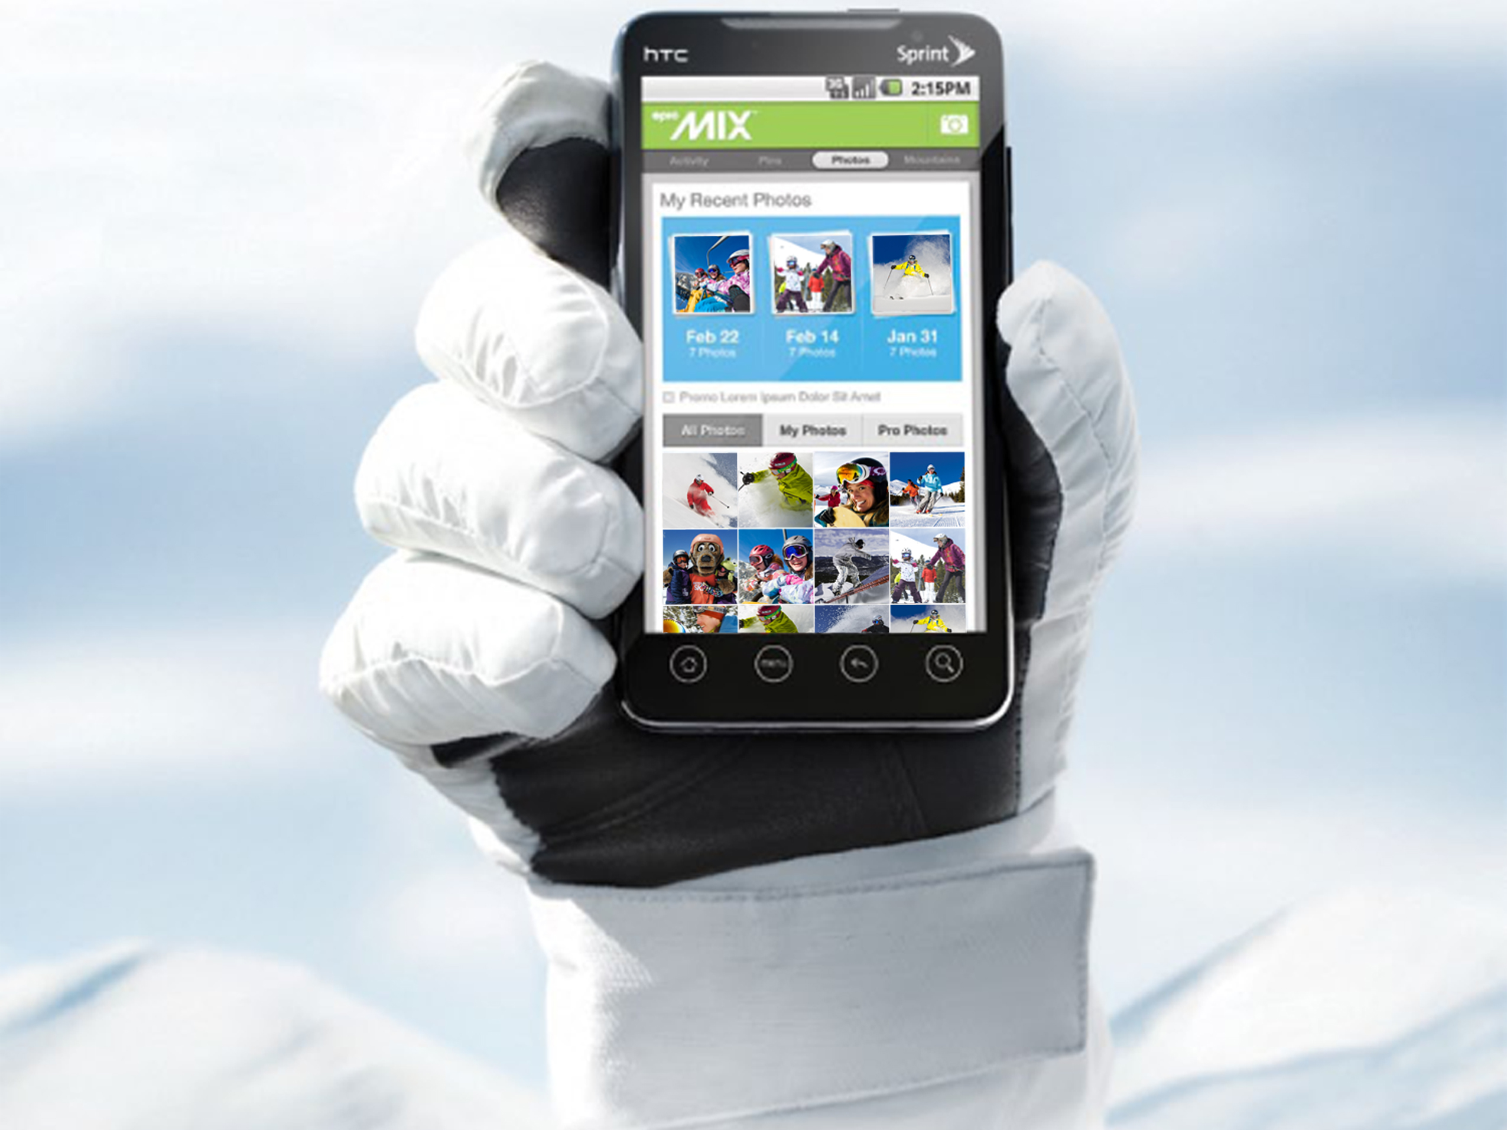
Case study: Technology woven into the DNA at Vail Resorts
Smart card technology: Express Ticketing
Epicmix card: hard card media

